Slide 1
Java Programs - Review
Dr.Preethi Ananthachari
AI & Big Data Dept
Endicott College of International Studies
Woosong University

Slide 2
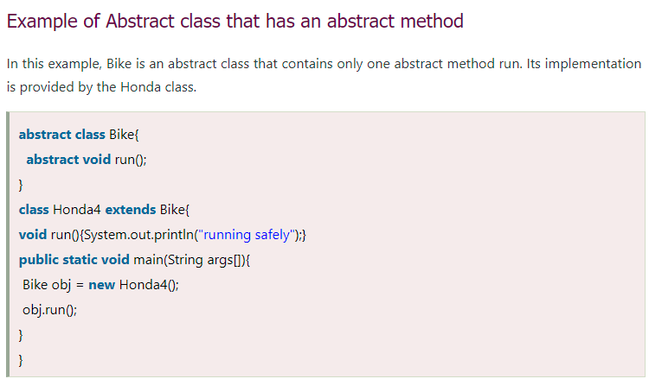

Slide 3
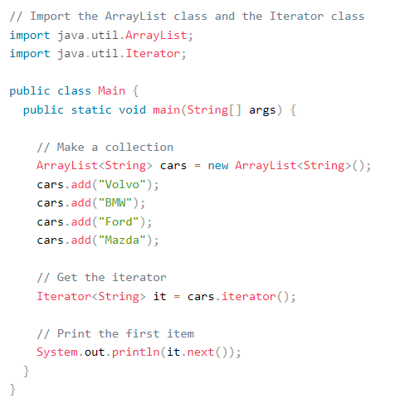
Arraylist - Iterator

Slide 4
Interface

Slide 5
